Slide 1
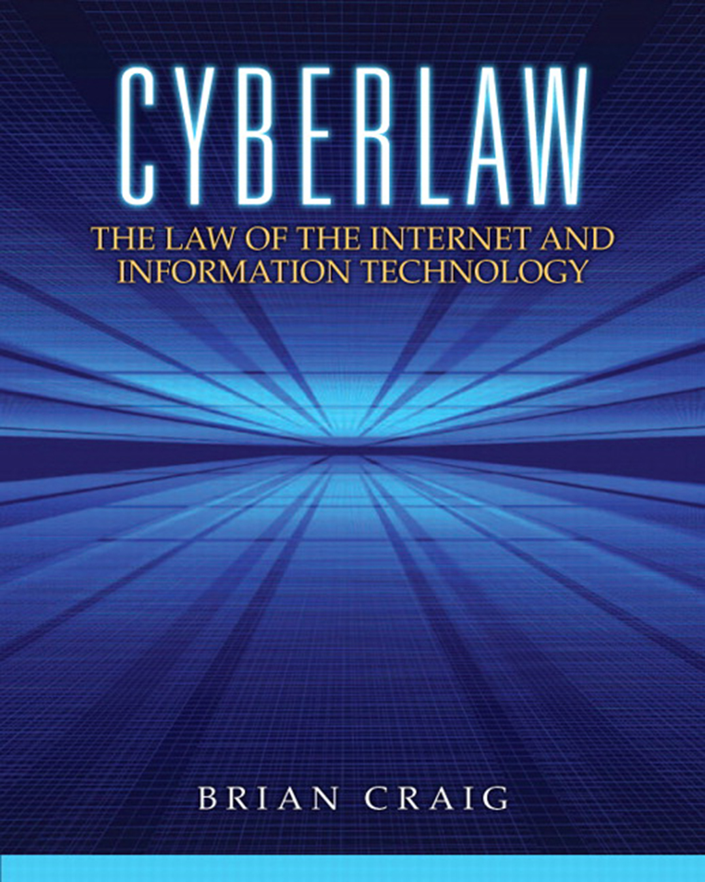

Cyberlaw: The Law of the Internet and Information Technology
First Edition
Chapter 3
Trademarks in E-Commerce
Copyright © 2013 Pearson Education, Inc. All Rights Reserved
Notes:
If this PowerPoint presentation contains mathematical equations, you may need to check that your computer has the following installed:
1) Math Type Plugin
2) Math Player (free versions available)
3) NVDA Reader (free versions available)

Slide 2
Learning Objectives (1 of 2)
After this lecture, you should:
3.1 Explain and define a trademark under the Lanham Act.
3.2 Explain the scope of trademark protection for Internet content, software and other technology-related products and services
3.3 Describe the marking requirements for trademarks, particularly for online content.

Slide 3
Learning Objectives (2 of 2)
3.4 Explain the likelihood-of-confusion test for trademark infringement actions.
3.5 Explain the purpose of the Anticybersquatting Consumer Protection Act of 1999 (A C P A) and the Trademark Dilution Revision Act of 2006 (T D R A)

Slide 4
3.1 Lanham Act
Lanham Act: Federal statute found in Title 15 United States Code, that governs trademarks
Trademark: any word, name, symbol, or device, or any combination thereof used to identify and distinguish one’s goods from those manufactured or sold by others to indicate the source of the goods

Slide 5
3.2 Examples of Trademarks
AIM, You’ve Got Mail, Bing
“Buddy List” – dispute between A O L and A T&T

Slide 6
3.2 Non-Generic Trade Names
A generic term cannot be registered as a trademark
In re Hotels.com: “HOTELS.COM” was to generic to receive trademark protection

Slide 7
3.2 Trademark Duration
Each registration remains in force for 10 years
  May be renewed for another 10 years
Provided the trademark continues to be used in commerce, trademark protection may last indefinitely

Slide 8
3.2 Trademark Registration
Registration with the U.S. Patent and Trademark Office (U S P T O)
Application with Trademark Electronic Application System (T E A S)
Official Gazette and Principe Register

Slide 9
3.3 Marking Requirements for Registered Trademarks
“®”
“Registered, U.S. Patent and Trademark Office” or
“Reg. U.S. Pat. & Tm. Off.”

Slide 10
3.3 Marking Requirements for Unregistered Trademarks
Unregistered marks: not governed by federal regulations
  May be governed by local, state, or foreign laws
Unregistered marks: “T M”
  Trademark
Unregistered marks: “S M”
  Service mark

Slide 11
3.4 Likelihood of Confusion Test Factors
Degree of similarity between the marks
Intent of the alleged infringer in using the mark
Evidence of actual confusion
Similarity of products and manner of marketing
Degree of care likely to be exercised by purchasers
Strength or weakness of the marks

Slide 12
3.4 Likelihood of Confusion Test
Plaintiff bears burden of proving by a preponderance of the evidence that likelihood of confusion exists
Surveys of customers often used to show consumer confusion

Slide 13
3.5 Anticybersquatting Consumer Protection Act of 1999 (A C P A)
Federal law authorizing a trademark owner to obtain a federal-court order transferring ownership of a domain name from a cybersquatter to the trademark owner
Purpose of the A C P A: prevent cybersquatting
Registering a domain name with the intent to sell it to the trademark owner is presumptively an act of bad faith

Slide 14
3.5 Trademark Dilution Revision Act (T D R A)
Law passed by Congress in 2006 to overturn holding of U.S. Supreme Court in Mosley v. V Secret Catalogue, Inc. which required plaintiffs to establish proof of “actual dilution”
Now under T D R A: plaintiff needs to only establish a “likelihood of dilution” and not “actual dilution”

Slide 15
Chapter Summary (1 of 2)
3.1 Explain and define a trademark under the Lanham Act
3.2 Explain the scope of trademark protection for Internet content, software and other technology-related products and services.
3.3 Describe the marking requirements for trademarks, particularly for online content.

Slide 16
Chapter Summary (2 of 2)
3.4 Explain the likelihood-of-confusion test for trademark infringement actions.
3.5 Explain the purpose of the Anticybersquatting Consumer Protection Act of 1999 (A C P A) and the Trademark Dilution Revision Act of 2006 (T D R A)

Slide 17

Copyright
This work is protected by United States copyright laws and is provided solely for the use of instructors in teaching their courses and assessing student learning. Dissemination or sale of any part of this work (including on the World Wide Web) will destroy the integrity of the work and is not permitted. The work and materials from it should never be made available to students except by instructors using the accompanying text in their classes. All recipients of this work are expected to abide by these restrictions and to honor the intended pedagogical purposes and the needs of other instructors who rely on these materials.

